Slide 1

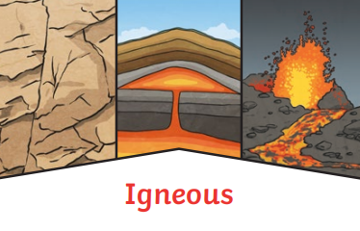

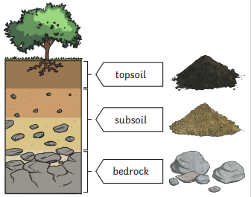
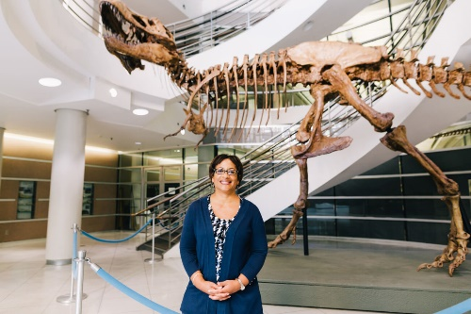
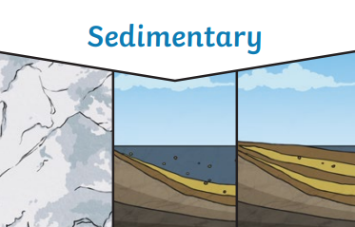
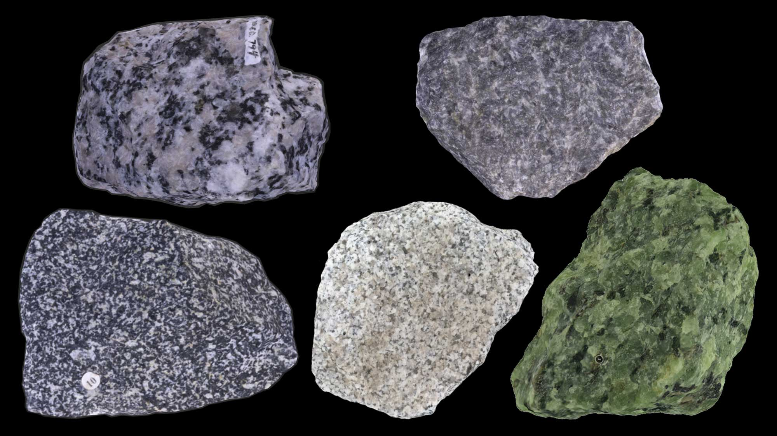
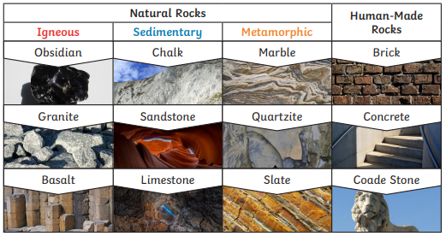
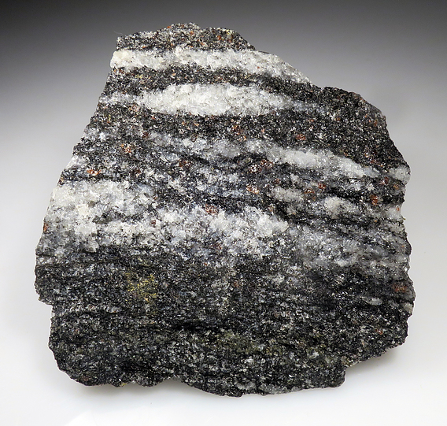
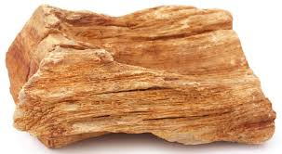
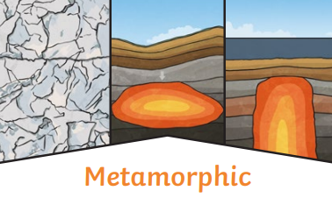

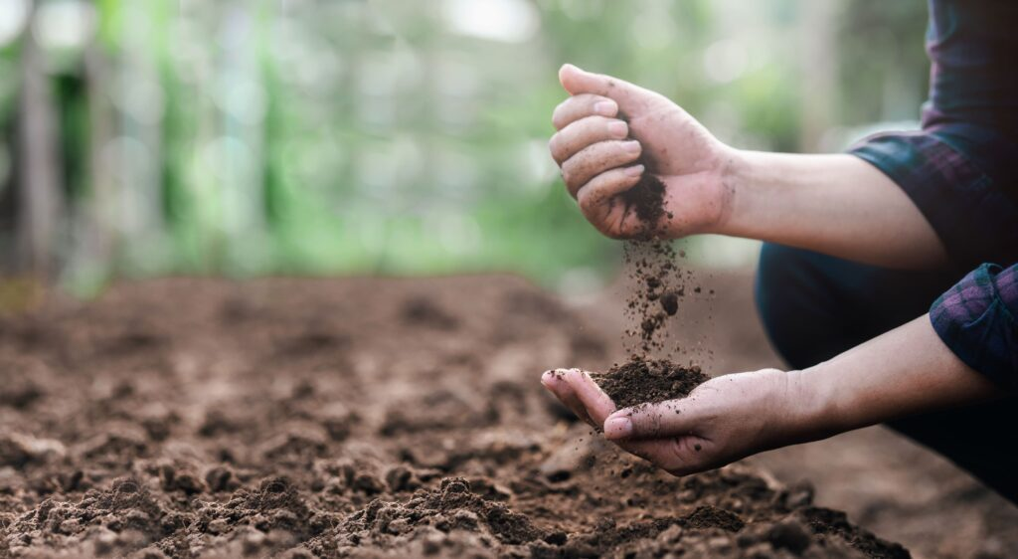
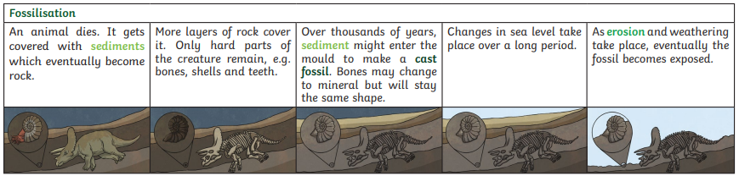

Materials and their properties
Sticky Knowledge
 | Dr. Lisa White is a geologist and educator who studies rocks and fossils to learn about Earth's history. She works at the University of California Museum of Paleontology.
 | Intrusive igneous rocks form inside the Earth over a long period of time, while extrusive igneous rocks form from molten lava that cools outside the Earth.
 | Metamorphic rocks start as either sedimentary or igneous rocks and changed through immense heat and pressure.
 | Sedimentary rock is when layers of sand, shells, bones, pebbles and other materials settle over a long period of time, the layers of sediment build up and pressure pushes the grains together to make rock.
 | Some rocks are impermeable. Impermeable means that they do not allow water to soak through. (e.g., marble and slate).
 | Soil is made from four things: worn down rock, organic matter (e.g. dead leaves/things that used to be alive), water and air.
Soil is the uppermost layer of the Earth. It is a mixture of different things:
minerals (the minerals in soil come from finely broken-down rock);
air;
water;
organic matter (including living and dead plants and animals).
Concept:
Community
Our learning links to the concept of cause and effect. As Scientists, we will explore how different processes, such as weathering, erosion, and heat and pressure, cause rocks to change over time and shape the Earth's surface.

Slide 2



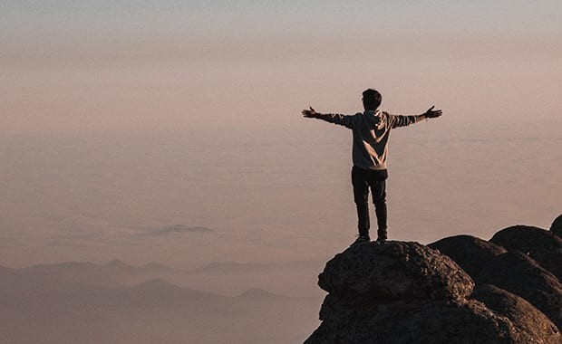
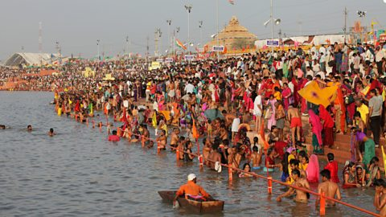





What happens after a disaster has passed?
Sticky Knowledge
 | Pilgrimages are important in many religions and express deep spiritual beliefs.
 | Sacred texts and sources of wisdom teach about religious journeys and their meanings .
 | Music and worship in Christianity help express faith and devotion.
 | Non-religious people may also go on personal journeys for reflection and growth.
How do different religions and worldviews use pilgrimage as a way to express spirituality?
Pilgrims wear or carry religious symbols (e.g., crosses, prayer beads).
Walking long distances, praying, and performing rituals.
Some people take personal journeys, such as walking long distances for reflection (e.g., the Camino de Santiago).
Meditation retreats help people find inner peace.
Travel to places of natural beauty can be a way to feel connected to something greater.
Singing hymns, chanting prayers, and reading sacred texts.
People use pilgrimage to seek guidance and deepen their faith.
Pilgrimages in Different Religions
Christianity – Pilgrimages to places like Lourdes (France) or Canterbury (UK) for healing, reflection, and connection to God.
Islam – Hajj to Mecca, one of the Five Pillars of Islam, is a duty for Muslims who are able to go.
Hinduism – Pilgrimages to the River Ganges for purification and connection with the divine.
Judaism – Visiting the Western Wall in Jerusalem to pray and seek connection with God.
Buddhism – Journeys to Bodh Gaya, where Buddha is believed to have attained enlightenment.
Sikhism – Pilgrimage to the Golden Temple in Amritsar, a place of spiritual importance and service.
By learning about different traditions, we develop mutual respect and tolerance, recognizing the diverse ways people seek meaning and connection.
Concept:
Community
As Religious Scholars, we explore how people express beliefs through journeys, music, and worship. We ask deep questions about sacred texts and consider what pilgrimage means to different people.

