Slide 1


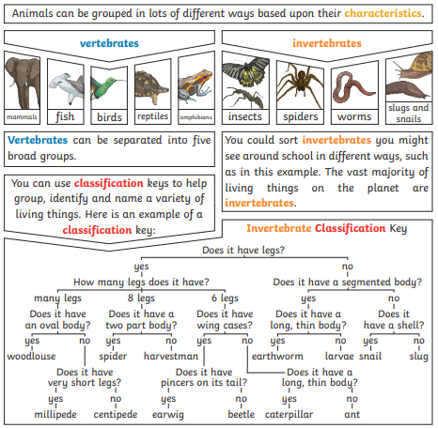
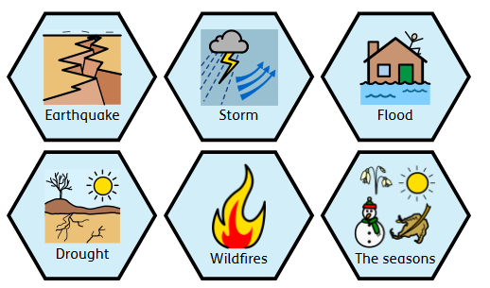
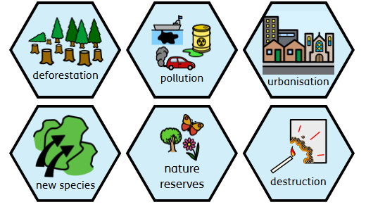
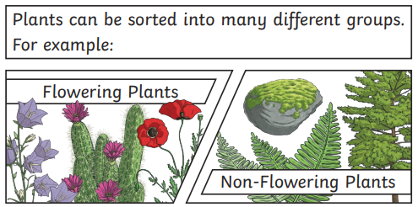

Animals and their habitats
Sticky Knowledge
Classification | Scientists look for similarities and differences between the characteristics of living things to organise them into groups.
Grouping | You can use the characteristics to keep on dividing them up into smaller groups. For example, animals can be sorted into vertebrates, which can then be divided into five groups: mammals, birds, fish, reptiles and amphibians.
Identification | There are so many different plants and animals on Earth that scientists need to divide them into groups to help identify them.
Impact | Humans do lots of things that damage the environment (like building on meadowland or cutting down trees).
Conservation | Some people work to protect living things and their environment.
To stay alive and healthy, all living things need certain conditions that let them carry out the seven life processes
Changes to an environment can be natural or caused by humans. Changes to an environment can have positive as well as negative effects. Here are some examples of things that can change an environment.
Movement, Respiration, Sensitivity, Growth, Reproduction, Excretion, Nutrition
Natural
Human-made
Concept:
Cause and Effect
Our learning links to the concept of cause and effect. As Scientists, we will explore how different factors, such as changes in the environment, availability of food, and human impact, affect animals and their habitats and influence how living things survive and adapt over time.

Slide 2






Who gave us more – the Ancient Sumer or the Ancient Egyptians?
Sticky Knowledge
 | Religions have differences, but many share common values like kindness and respect.
 | People express their beliefs in different ways, through worship, traditions, and community.
 | Not everyone follows a religion, and it’s important to respect different perspectives.
 | Asking big questions helps us understand the world and each other better.
What is a religion?
Religions help people understand the world and their place in it.
Most religions have key beliefs, places of worship, and sacred texts.
Religion
Faith
Belief
Sacred
Pilgrimage
Worship
Equality
Community
Tolerance
Are all religions equal?
Just how important are our beliefs?
Religion | Place of Origin | Key Figure(s) | Sacred Text
Christianity | Israel | Jesus Christ | Bible
Islam | Saudi Arabia | Prophet Muhammad | Qur’an
Hinduism | India | No single founder | Vedas, Bhagavad Gita
Buddhism | India | Siddhartha Gautama (Buddha) | Tripitaka
Sikhism | India (Punjab) | Guru Nanak | Guru Granth Sahib
Judaism | Israel | Abraham, Moses | Torah
By learning about different beliefs and communities, we develop mutual respect and tolerance, recognizing the diverse ways people express faith, belonging, and identity.
Concept:
Significance
As Religious Scholars, we explore how people express beliefs through faith, traditions, and community. We ask deep questions about religious equality, the importance of beliefs, and how belonging to a religion shapes people's lives.

