Slide 1


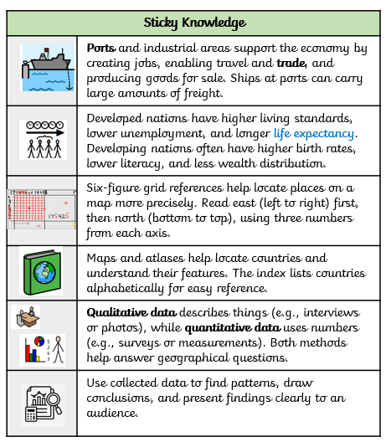

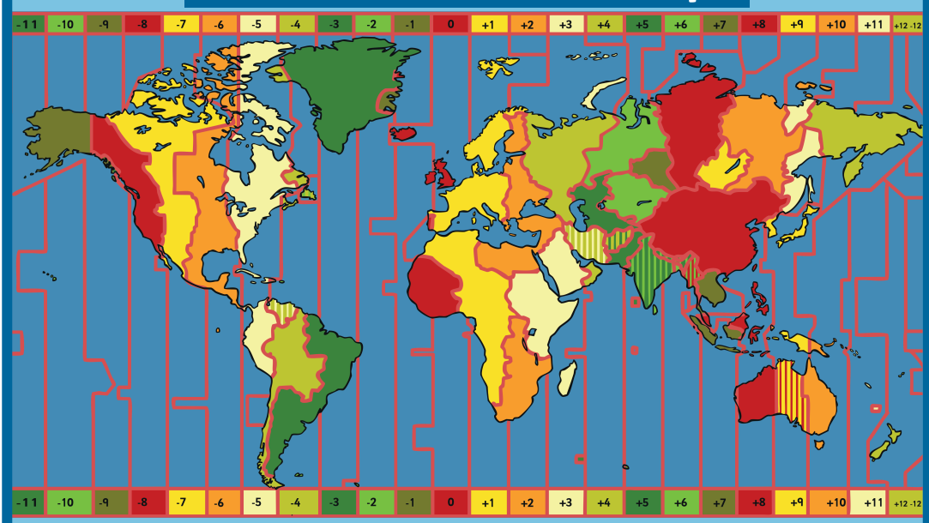
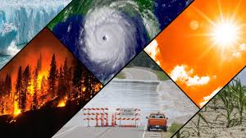




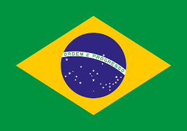
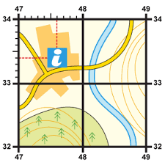
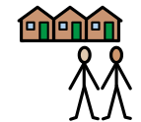
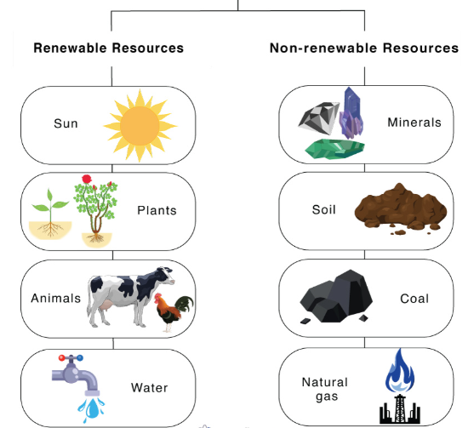
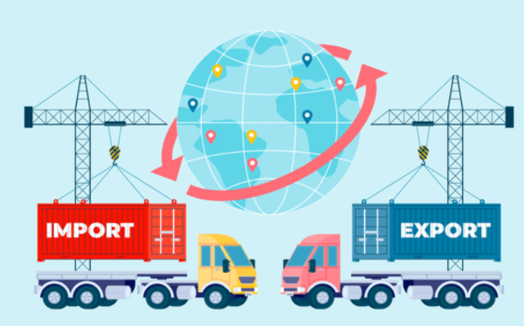
Should your circumstance determine your destiny?
World Time Zones Map
Fair Trade is a trading system that aims to improve the conditions for producers and workers in developing countries.
Climate change causes natural disasters which impacts on peoples lives causing migration.
Developed Countries | Developing Countries
United Kingdom Italy | Syria Brazil
Prime meridian
Six figure grid references are used to pinpoint an exact location on a map
Concept:
Community
Our learning links to the concept of community. As Geographers, we will use the Human Development Index (HDI) to explore how developed and non developed countries have differences such as different living standards and life expectancies.
Climate change is making some communities inhabitable.
Natural resources
Natural resources can impact a countries rate of development, which impacts living standards.
Trade is the buying and selling of goods. Countries can trade with other countries.
Imports are bought into the country
Exports are sent out of the country

