Slide 1

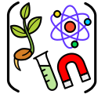
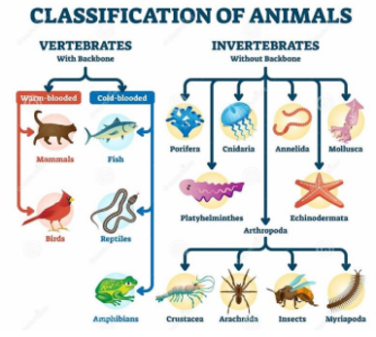
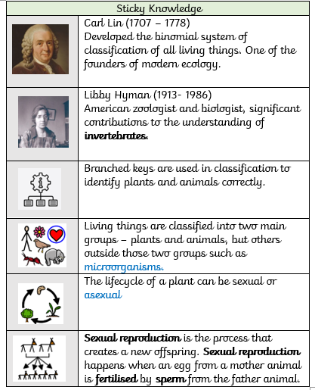
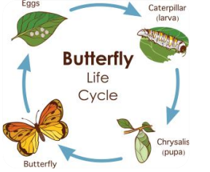
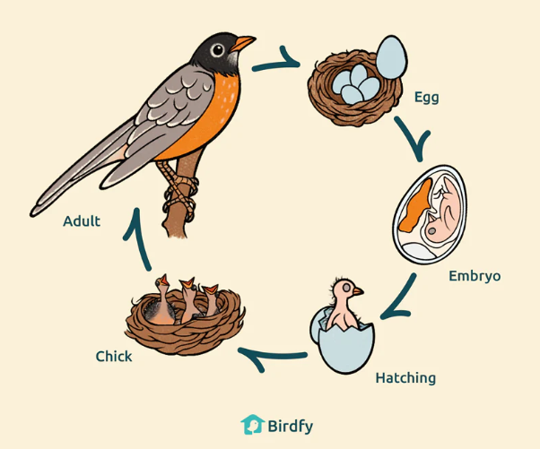
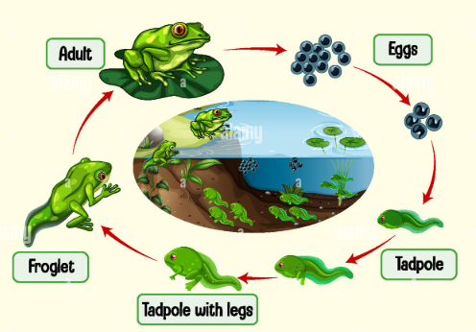
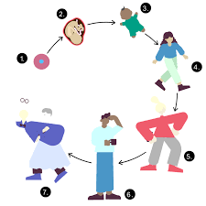
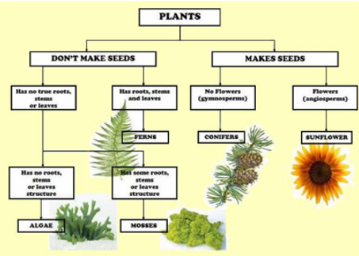
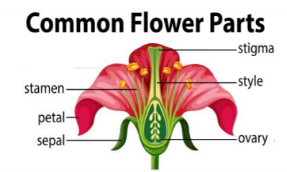
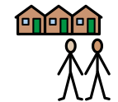
Living things and their habitats
All livings things go through changes during their lifetimes. These changes make up their lifecycle.
C
l
a
s
s
i
f
i
c
a
t
i
o
n
Animals are divided into two groups – vertebrates and invertebrates
Plants can be divided into two groups- flowering and non-flowering.
Concept:
Community
Our learning links to the concept of community. As Scientist, we will explore how different species interact within their habitats and contribute to a balanced ecosystem.
Pollination happens when the pollen from one plant lands on the stigma of another

