Slide 1




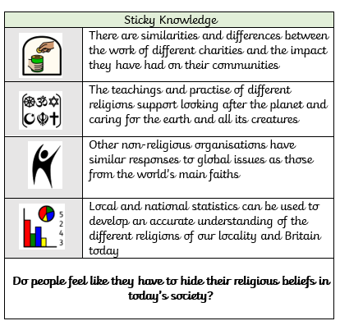








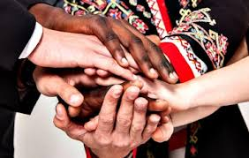



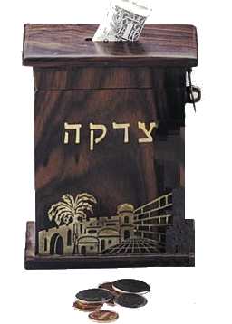


How do different worldviews help in times of crisis?
Christianity
As Rivendellians, we make our own charitable contributions.
Charities express spiritual ideas and put values of justice and compassion into action.
Islam
Hindu
Judaism
Humanism
Mutual respect and tolerance fosters interfaith cooperation and harmony in our communities.
Concept:
Community
As Religious Scholars, our learning connects to the concept of community as we explore shared values like justice and compassion, reflected in faith-based and non-religious aid, interfaith cooperation, and moral teachings that promote respect and collective responsibility.
Generosity is an important part of each religion and has special names in each:
Hinduism: Dana
Islam: Sadaqah
Judaism: Tzedekah
Christianity: charity

