Slide 1


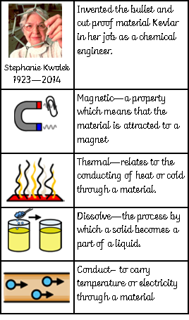
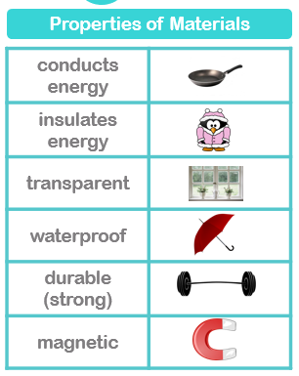
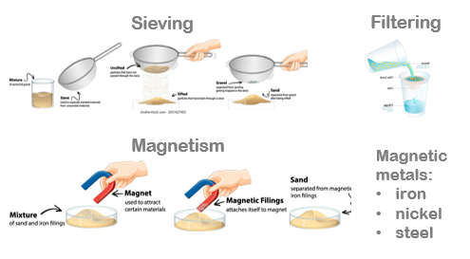
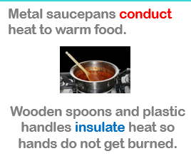


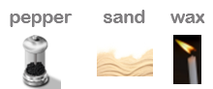
Properties of Materials
All objects are constructed from materials. Some are natural and some are man-made.
Different materials have different properties that make them suitable for a range of applications.
Separating
Materials
Concept:
Cause and effect
Our learning links to the concept of cause and effect as we are looking at the way in which the properties of a material make it suitable for a purpose. .
Soluble materials do dissolve in water
Insoluble materials do not dissolve in water

