Slide 1


Parent Consultation
Relationships, Sex and Health Education
RSHE – an integral part of our Rivendell Personal Development Programme!
Education for now, next and beyond!

Slide 2
Jargon Buster
Through out this Parents Guide, I will be using some terminology to talk about the areas that children will learn when they are in school with us. I have added the terms below with the explanation of what they mean.
PSHE – Personal, Social and Health Education
RSHE – Relationships, Sex and Health Education
SMSC – Spiritual, Moral, Social and Cultural

Slide 3

Our Rivendell RSHE Curriculum Aims
At Rivendell Flying High, we know the experiences a child has during the formative years of their life has such an impact on the kind of person they will develop into and become in the future. Such a lot of this important time is spent in school so it is essential that we work in partnership with parents so that we can make a positive difference and create a strong foundation that can be built upon as children continue to grow, develop and flourish.
The aim for our RSHE curriculum is to help our children to build healthy and positive relationships in an age-appropriate way. An important part of RSHE at Rivendell is the ability to discuss and debate issues with clarity, and listen to people’s points of view, whilst understanding that you do not have to agree with them but recognise their point of view.
The overall objectives of the RSHE curriculum are concerned about raising awareness of attitudes and values, developing personal and social skills and promoting knowledge and understanding. RSHE will look at aspects of diversity in an inclusive and non-judgemental way. At Rivendell, we whole-heartedly support the philosophy of RSHE and ensure that it is an integral part of our curriculum.

Slide 4

Why do we teach our children RSHE?
Children and young people are growing up in an increasingly complex world and a large part of their life is online;
This presents many positive and exciting opportunities but also many risks and challenges;
In this ever-changing environment, children need to be taught about how to stay safe and healthy, and manage their academic, personal and social lives in a positive way;
The Children and Social Work Act 2017 introduced a new legislation on Relationship Education, Relationships and Sex Education and Health Education in School;
Safeguarding children is at the heart of everything we do at Rivendell and this includes our Relationships and Sex Education.

Slide 5
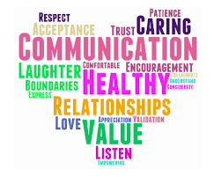
Why is Relationships and Sex Education in Schools Important?
High quality RSHE ensures children and young people are equipped with the knowledge, understanding, skills and confidence to cope with the many pressures and challenges of modern society. Learning about friendships and family in RSHE are the building blocks to help children to understand themselves and others. Knowledge alone is not enough.
RSHE makes an important contribution to health and wellbeing by supporting children and young people's ability to learn, achieve and flourish.
Schools maintain a statutory duty under the Children Act 2004 to promote their students’ well-being and, under the Children Act 2002 to prepare children and young people for the challenges, opportunities and responsibilities of adult life.
Technology is evolving at a rapid pace. The need to protect our children and young people form inappropriate online content, cyber bullying and exploitation is a growing concern. A comprehensive RSHE programme can support in addressing these issues.

Slide 6

Relationship Education at Rivendell
Relationship education is compulsory for all primary age pupils;
Health education is compulsory for all pupils;
Teaching of RSHE at Rivendell will complement and reinforce lessons families teach their children as they grow up;
We promote the needs and interests of all children, inclusive of gender, sexual orientation, race, religion, culture, ability or aptitude. Our approaches to teaching and learning take into account the ability, age, readiness and cultural backgrounds and home circumstances of our children to ensure that all can access the full RSHE provision.

Slide 7

Sex Education at Rivendell Flying High
The Department for Education continues to recommend that all primary schools offer a sex education programme. Sex education is not compulsory in primary schools and parents have a right to withdraw their child from dedicated ‘sex education’ lessons, however, we advise asking to see the teaching content before making this decision.
Our RSHE program is based on the needs of all our children at Rivendell, with age appropriate learning outcomes. RSHE will be firmly embedded within our broader curriculum areas, including personal development, science and PE, in addition to more focused learning through specific sessions.

Slide 8
The Christopher Winter Project – RSE Scheme of Work
At Rivendell, Relationships and Sex Education will be taught through the Christopher Winter Project (CWP) Scheme of Work, lessons will be taught by school teachers and, where appropriate, outside visitors and professionals;
The Relationships and Sex Education and Health Education Statutory Guidance (2019) was used to develop the CWP Scheme of Work;
The Rivendell RSHE curriculum and content and outcomes are taught in the following identified curriculum strands:
- Personal, Social and Health Education (PSHE)
- Sex Education
- Science Curriculum

Slide 9
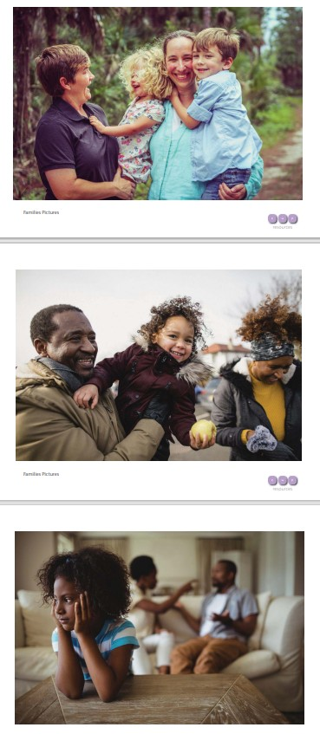
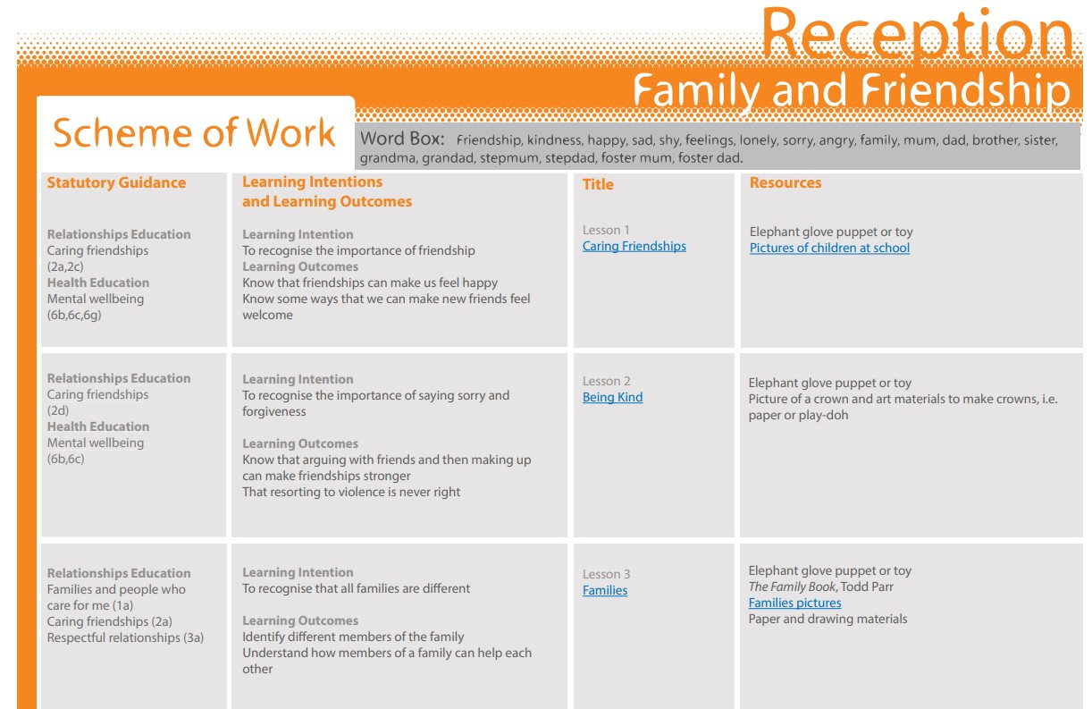
Reception Lesson Overview and Resource Example

Slide 10
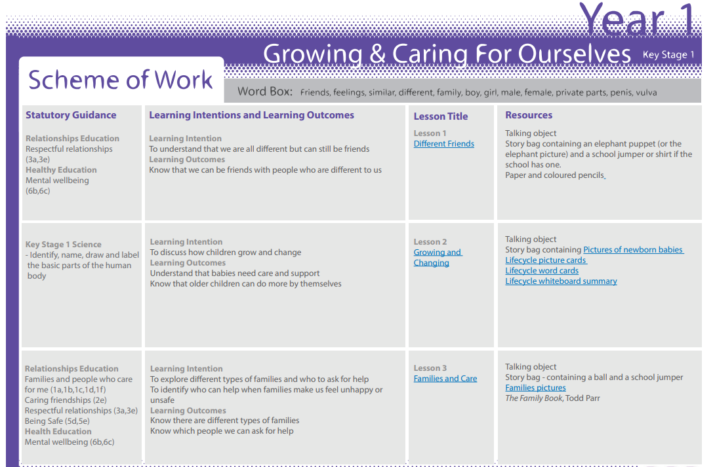
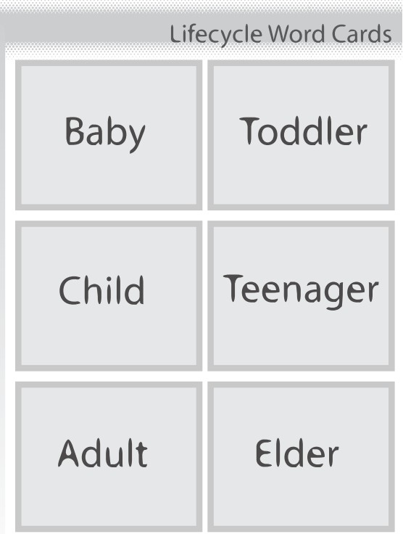
Year 1 Lesson Overview and Resource Example

Slide 11
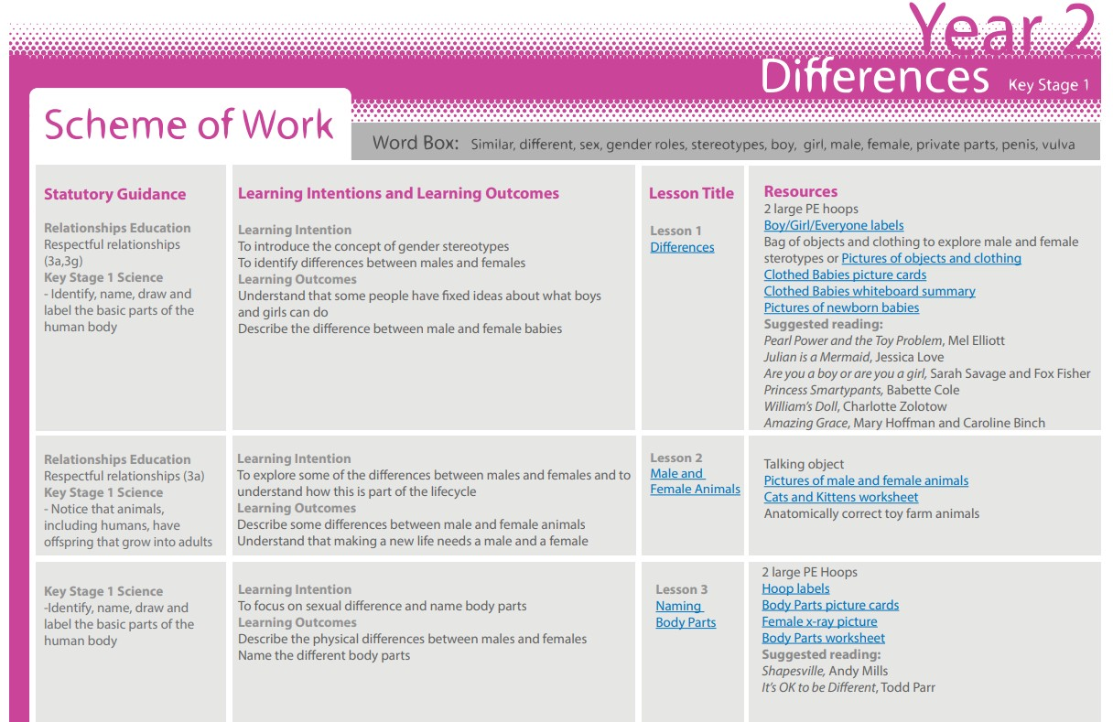
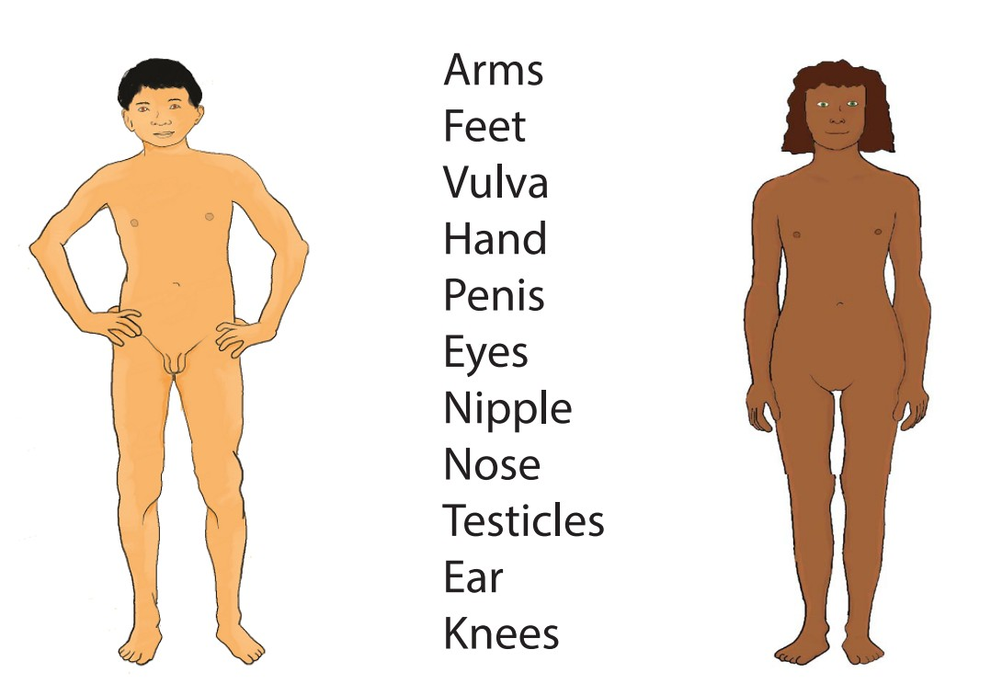
Year 2 Lesson Overview and Resource Example

Slide 12
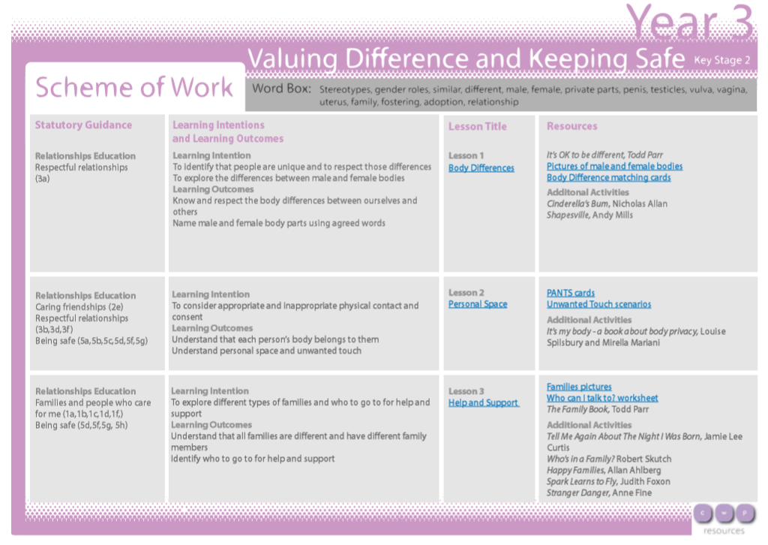
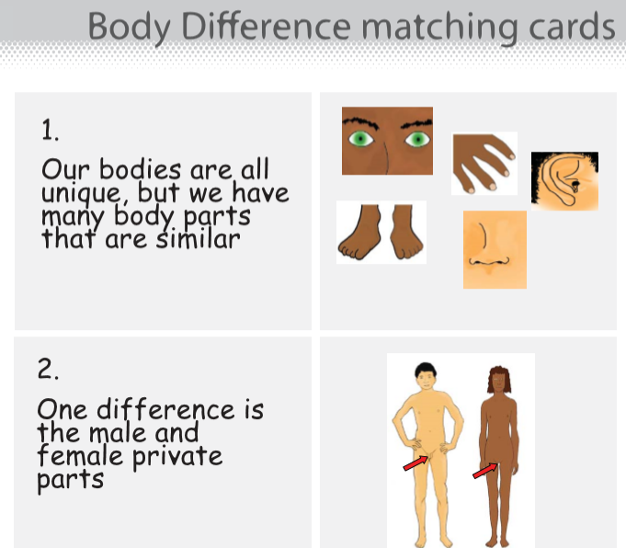
Year 3 Lesson Overview and Resource Example

Slide 13
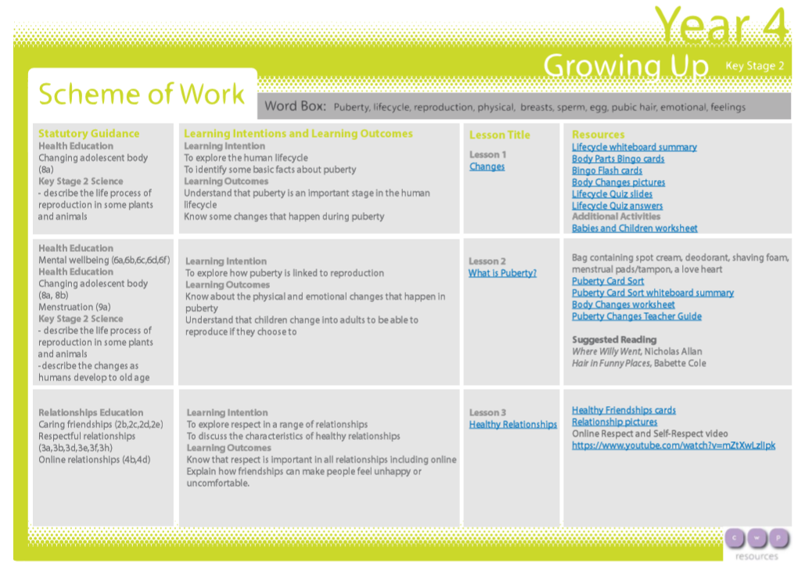
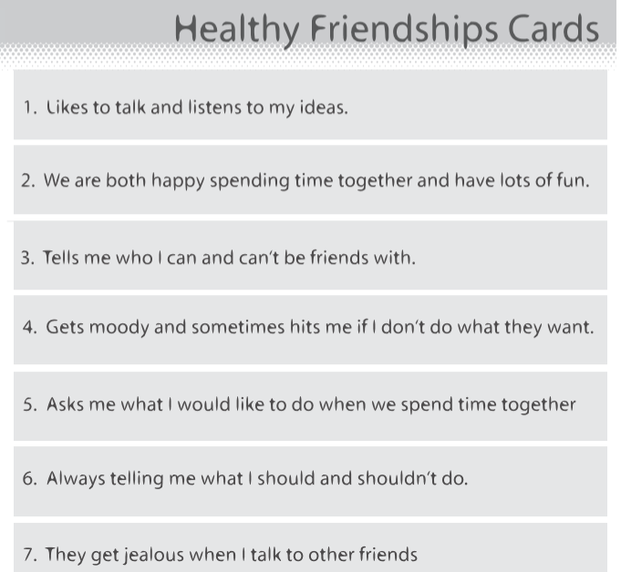
Year 4 Lesson Overview and Resource Example

Slide 14
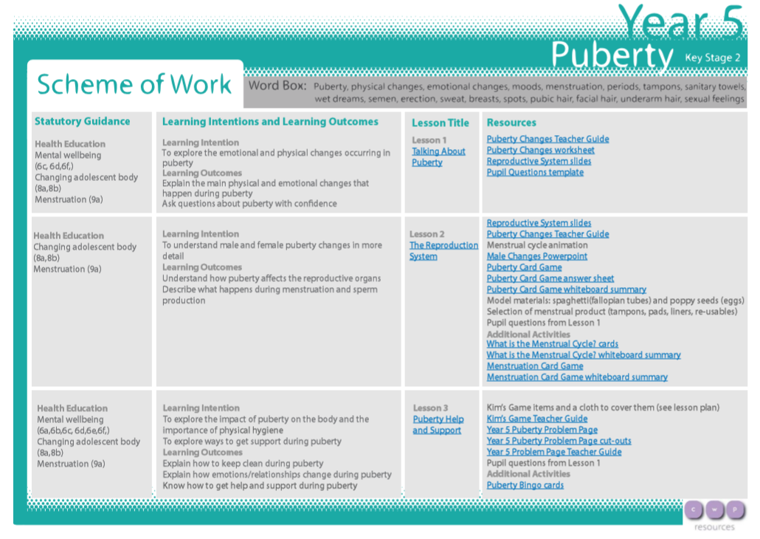
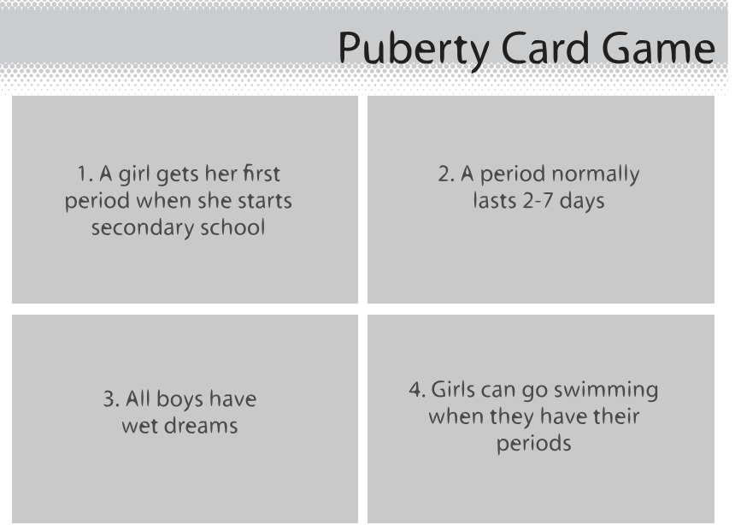
Year 5 Lesson Overview and Resource Example

Slide 15
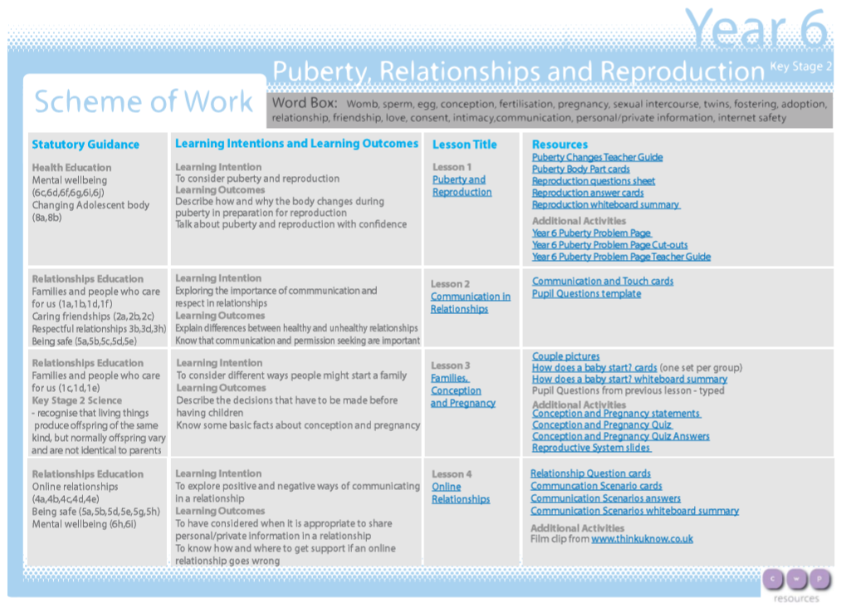
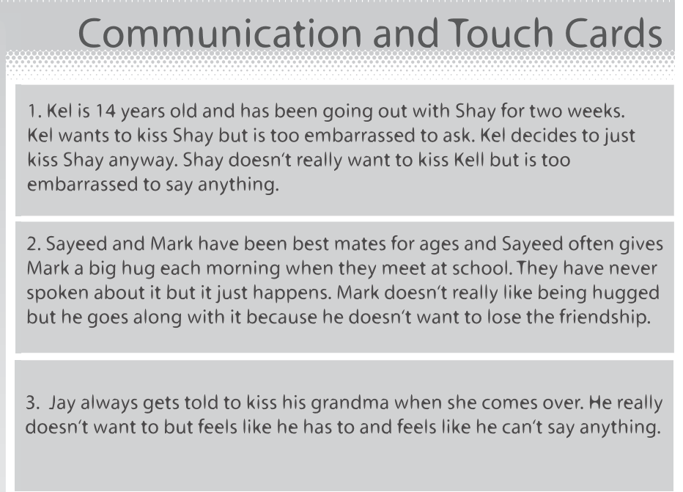
Year 6 Lesson Overview and Resource Example

Slide 16
Wider School Approach
All of these subjects are set in the context of a wider school approach, as a branch of the Rivendell Personal Development offer. This supports our children to be safe, happy and prepare for life now, next and beyond.
An example of this is how our RSHE curriculum is supported by the school’s wider policies on Positive Behaviour and Restorative practise, Inclusion, Equality and Diversity, Bullying, Protected Characteristics and Safeguarding.

Slide 17

Rivendell RSHE Policy
A draft RSHE policy has been drawn to reflect current statutory guidance including the RSHE curriculum offer.
The draft policy can be found on the school website: https://www.rivendellfha.co.uk/ and navigate to Curriculum > Personal Development > RSHE.
WE NEED YOUR HELP! We want to hear your thoughts about our policy and gain your feedback on what your children will be learning about the subject.

Slide 18

How you can Help our School
Please read the draft RSHE Policy 2024-25
Please look at the class overviews for the RSE content.
Please read the DfE Guidance for parents, Statutory Guidance and FAQ’s.
Please complete our parent consultation questionnaire (on our RSHE webpage) and feedback your thoughts and views.
School will address parent thoughts, views and concerns and reflect these in the final policy.

Slide 19

Thank you!!

