Slide 1


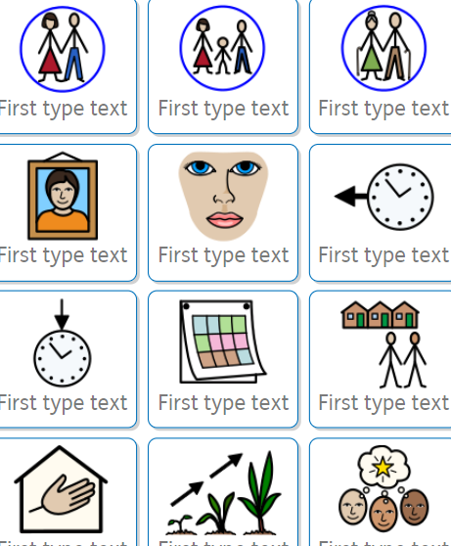

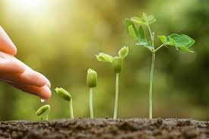
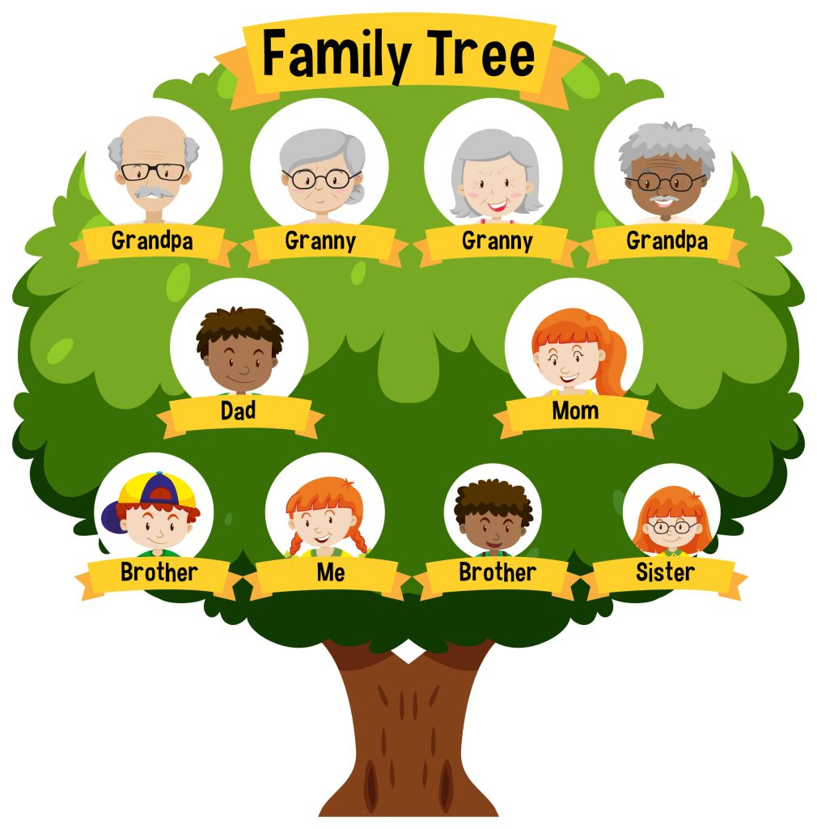
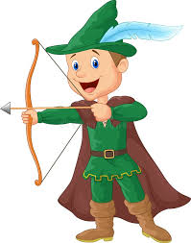

Foundation 2
History: Who Is Significant?
Subject vocabulary
family Unit | Family is defined as a group of people consisting children, parents, aunts, uncles, cousins and grandparents.
parents | A mother or father of a person or an animal,
grandparents | A parent of your mum or dad.
portrait | Drawing of a person's face.
features | Eyes, ears, nose, mouth, hair on a face.
past | Just happened or a long time ago.
present | Things that happen right now.
year | 365 days.
community | A group of people that live in the same place.
legacy | Alasting impact and the way they will be remembered for generations to come
care | To look after something to keep it alive.
grow | To get bigger over time.
famous | Known by lots of people.
infamous | Known for being a bad person.
remain | Stays the same.
consequence | A result of something happening.
question | To find out more information.
Sticky Knowledge
ADR.9 | A face contains nose, ears, eyes and mouth.
HR.4 | Each family is made up of a variety of different members.
HR.1 | Past events might include anniversaries, weddings, birthdays, Christmas, Bonfire night etc.
HR.5 | Locality is the area around where we are and this can change.
SBR.9 | After planting, seeds need sunlight to grow, regular water and soil to grow
HR.6 | Important people from the past are remembered in different ways.
HR.14 | Change means something does not remain the same.
HR.2 | Stories can tell us about people from the past.
HR.8 | Questions help us to understand more.
HR.14 | Objects from a long time ago can look different from objects from today e.g. cameras, cars, washing machines etc.

