Slide 1

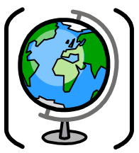
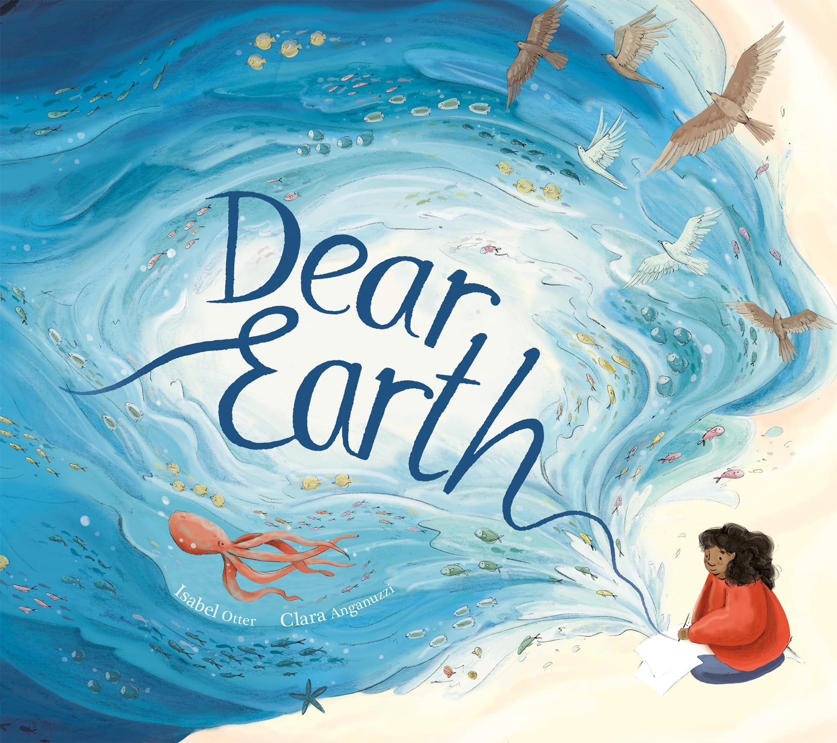


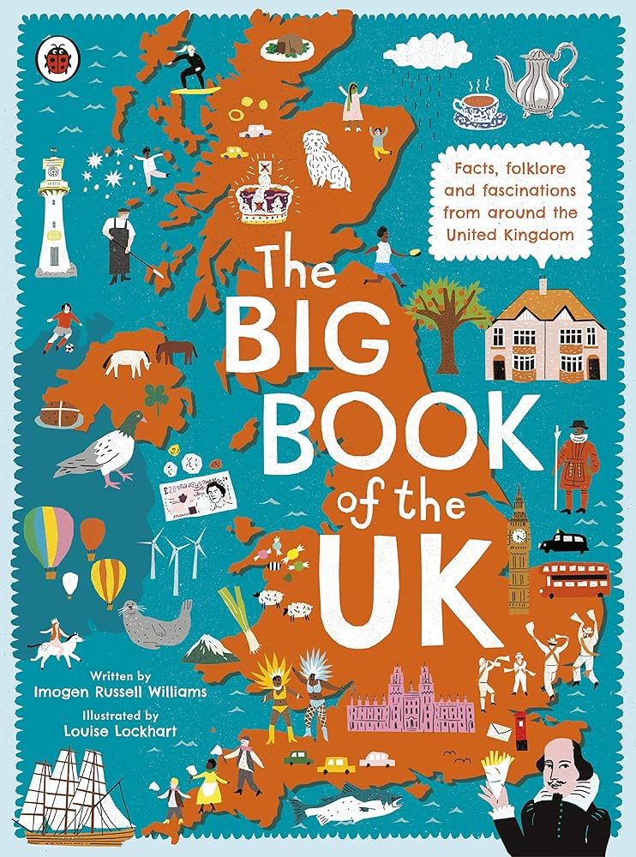


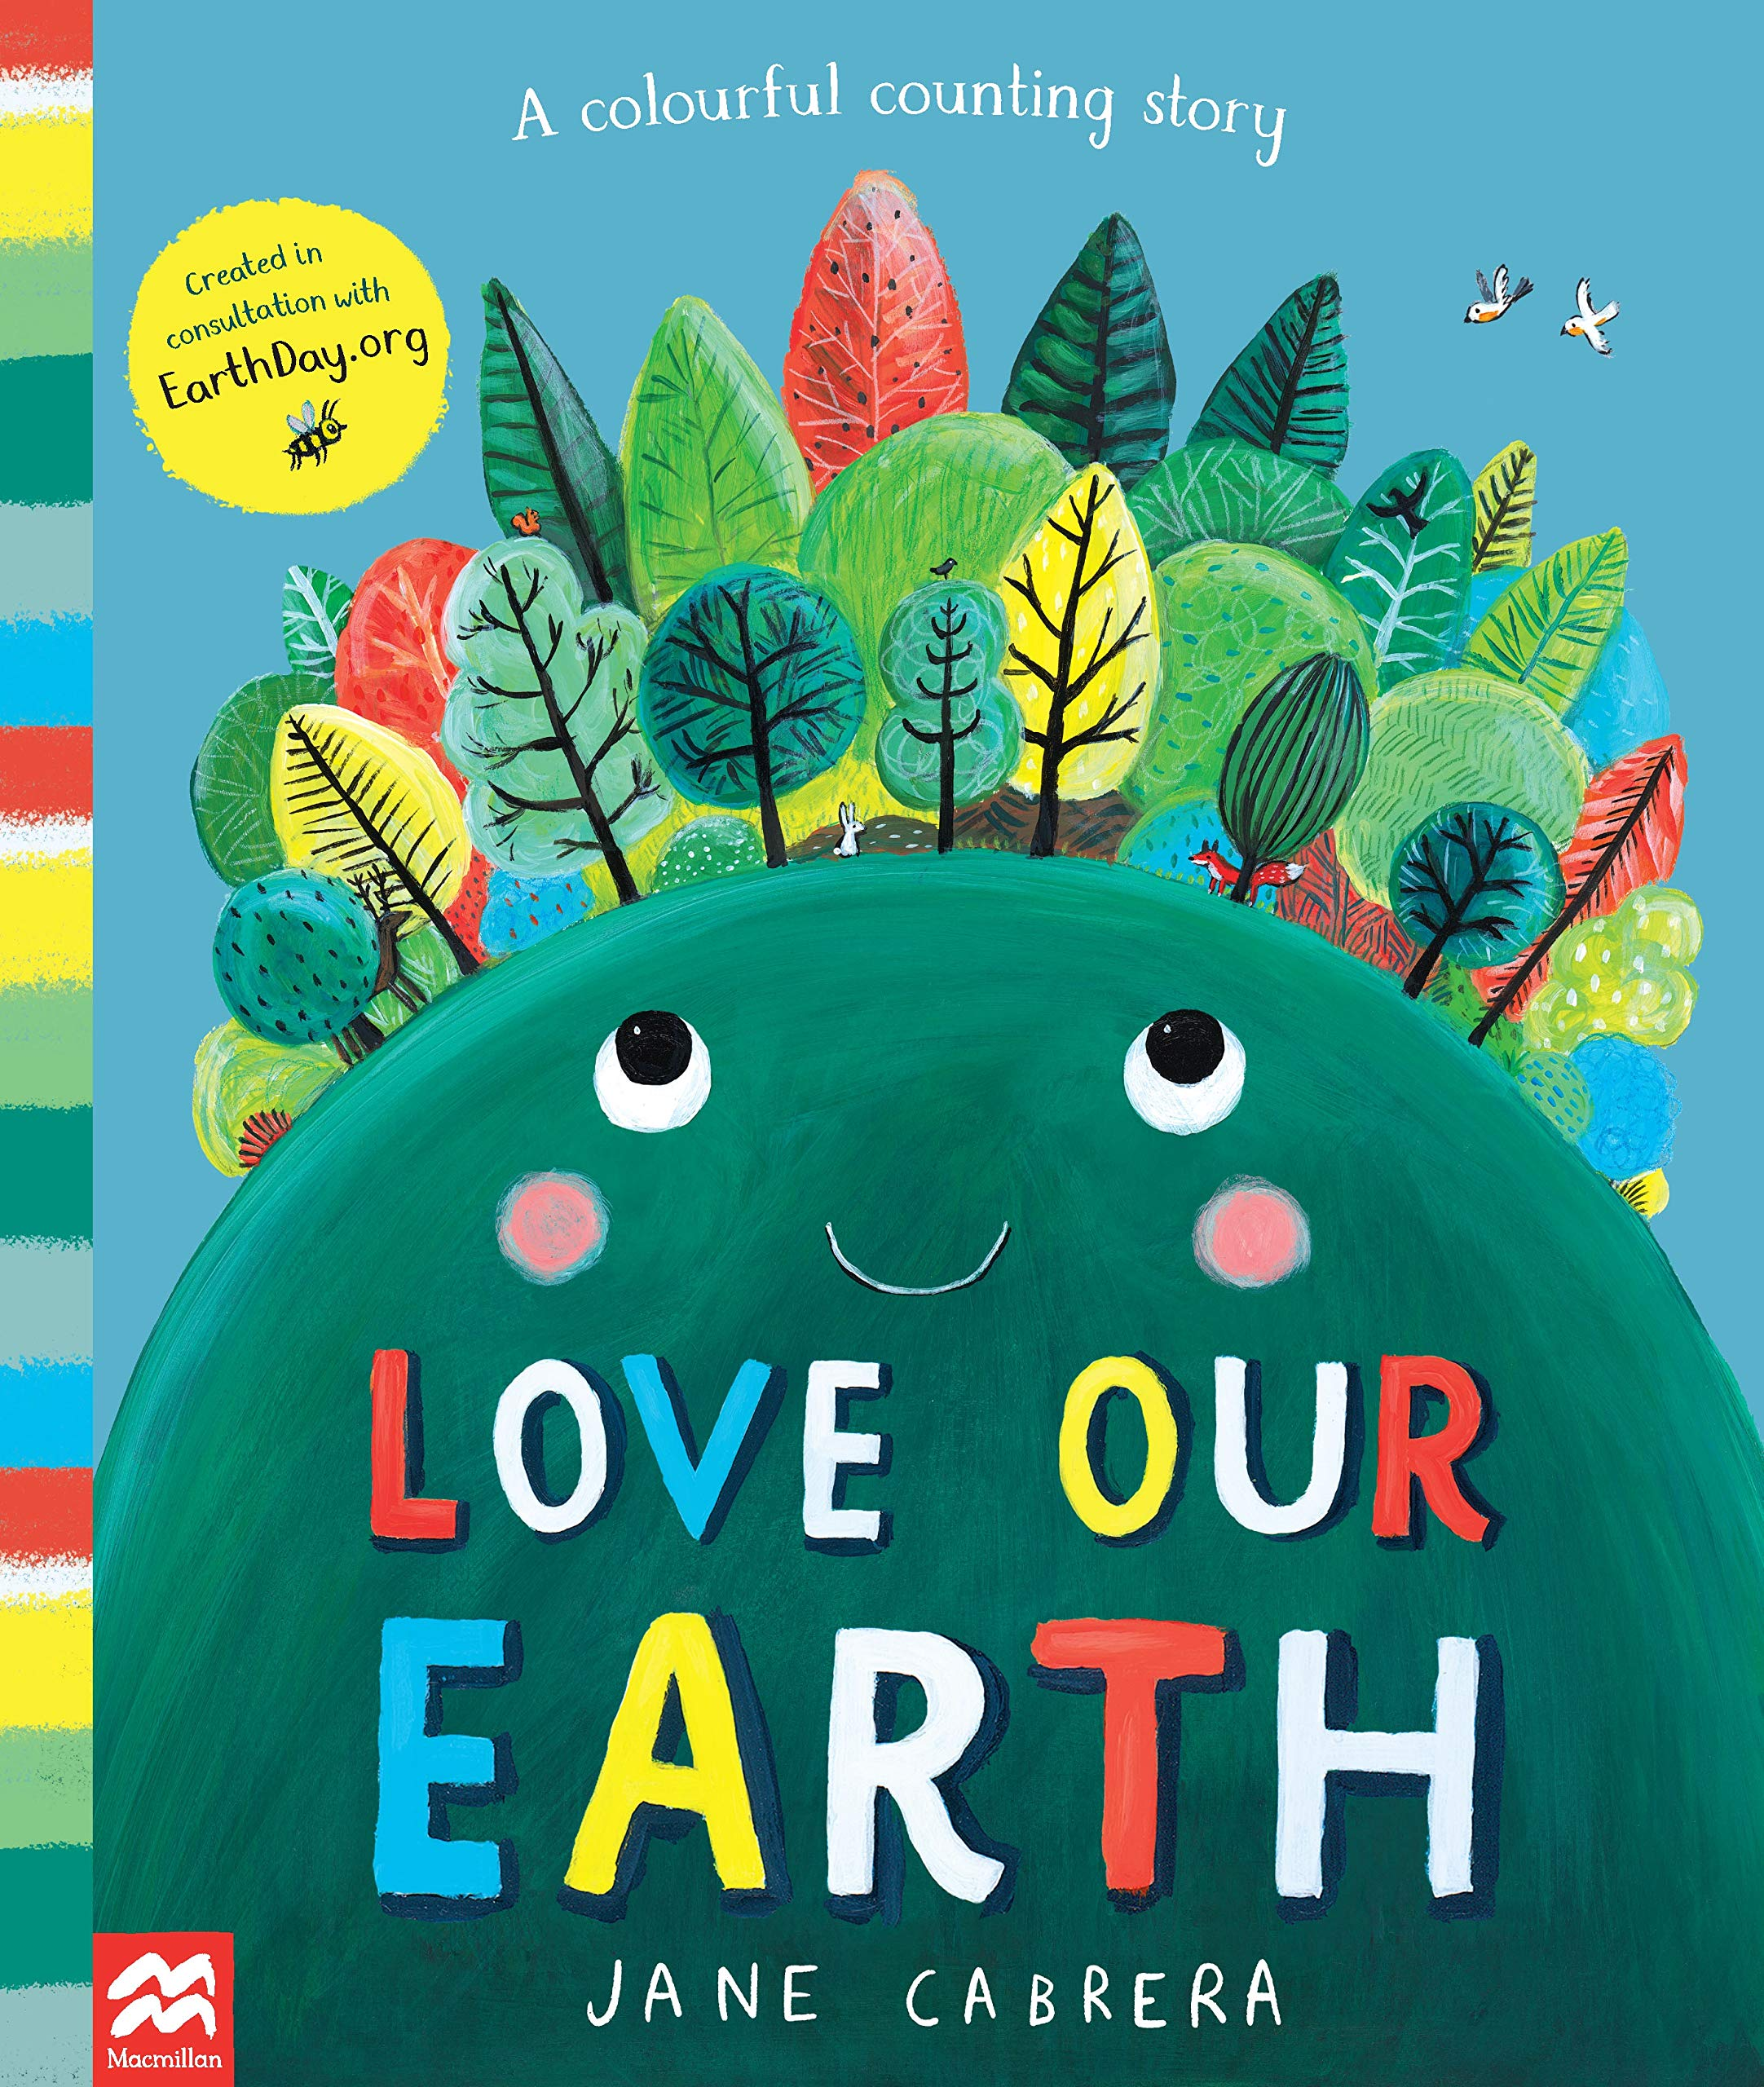


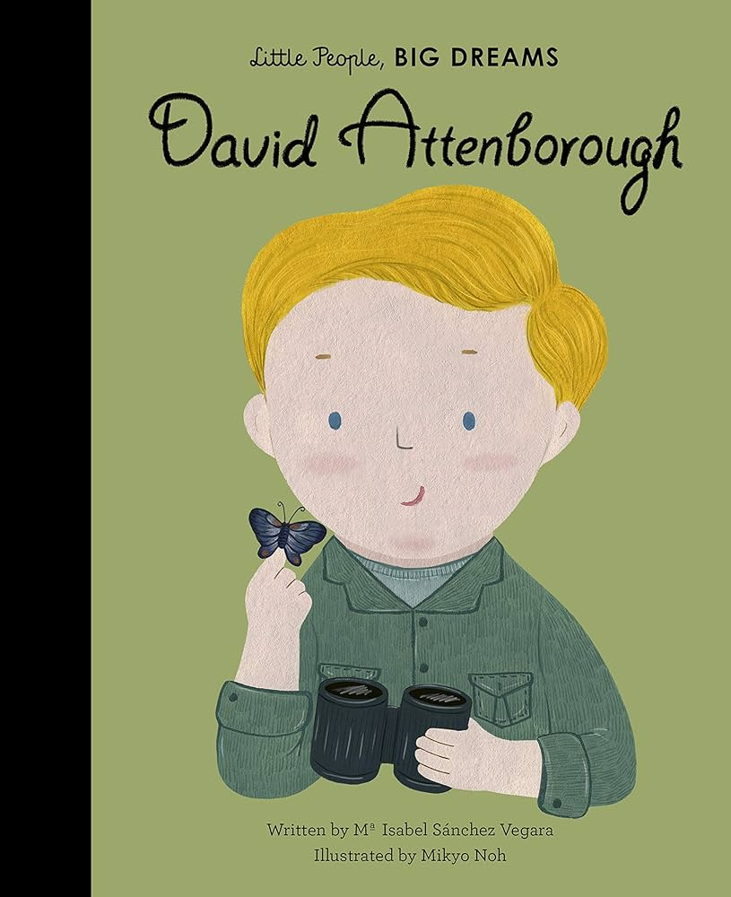

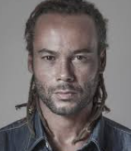
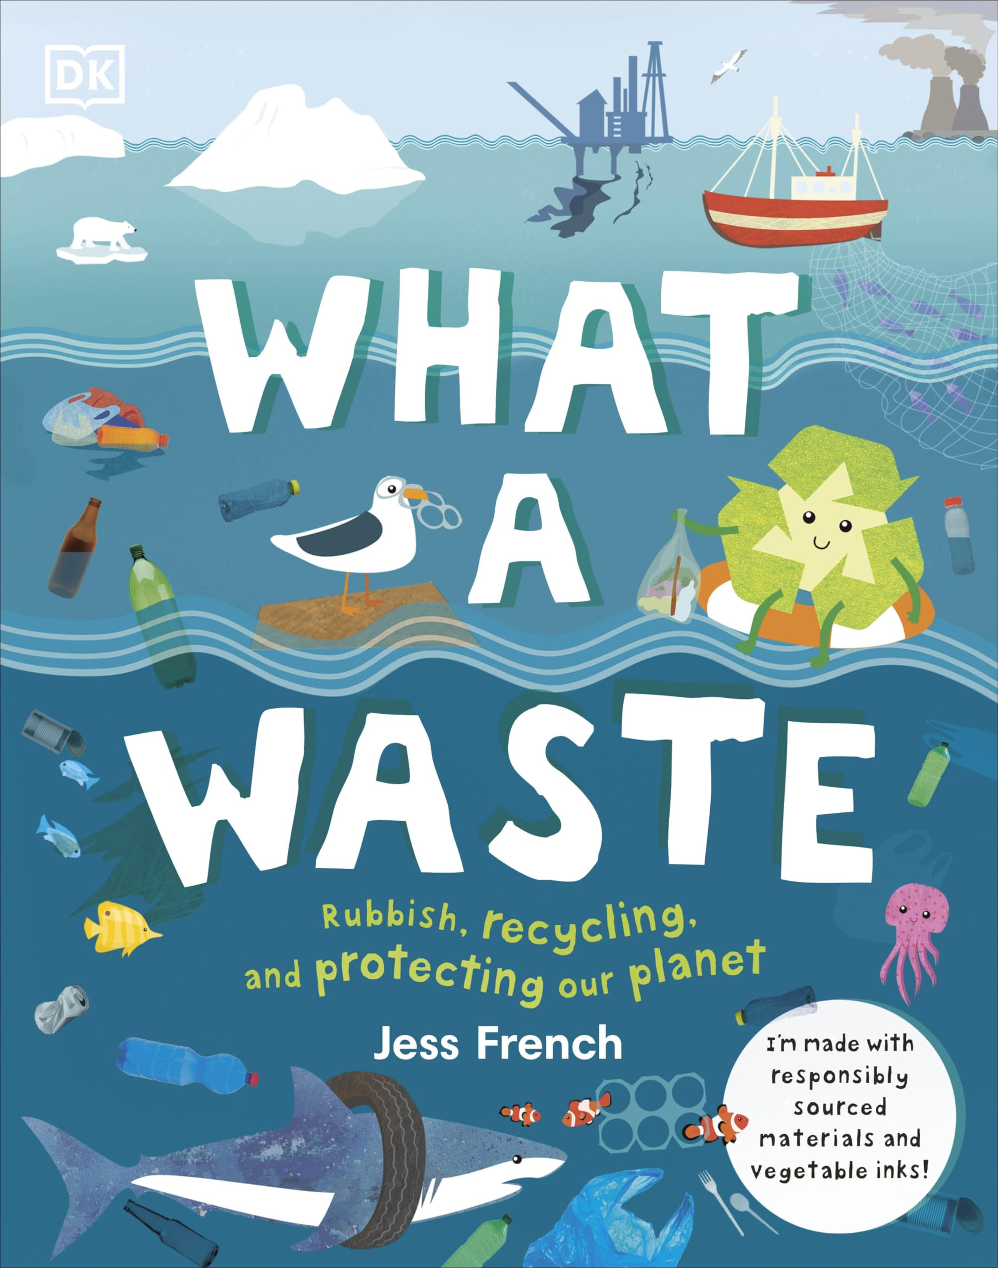



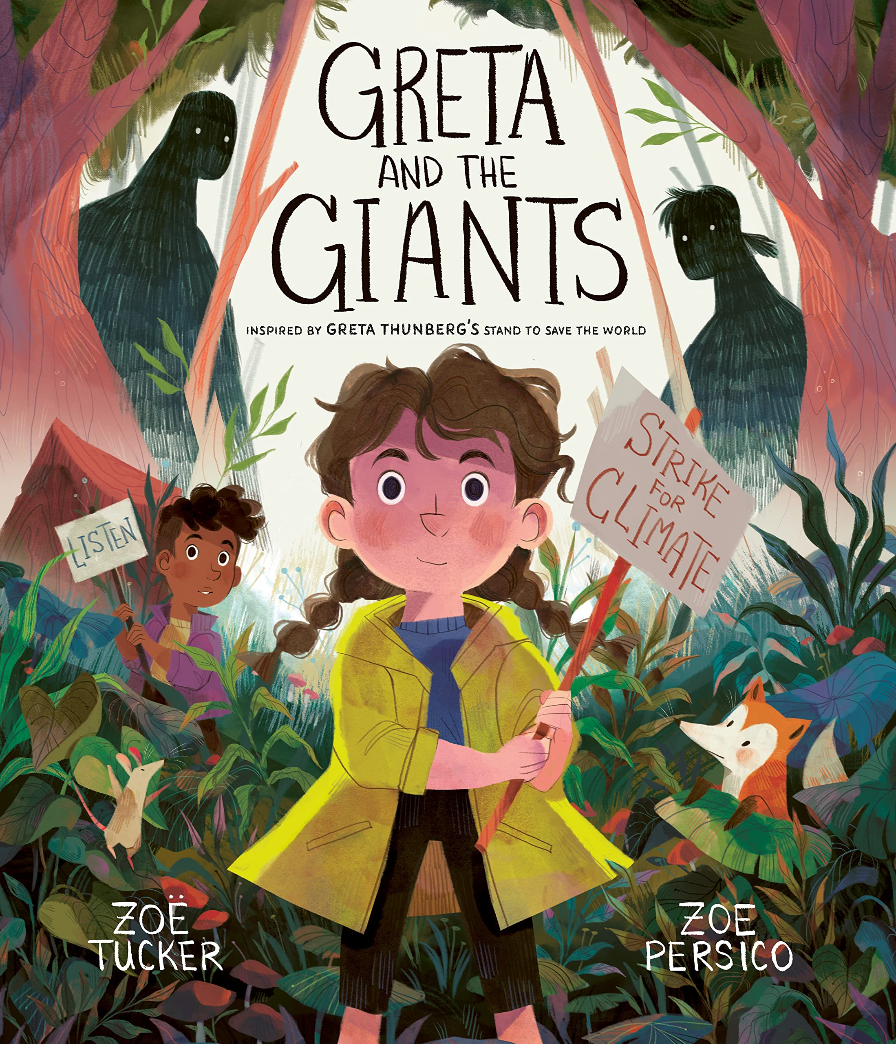


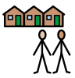
Reception
Geography: How can we make a difference?
Subject vocabulary
Nottingham City | The city that we live in.
England, United Kingdom | The country that we live in.
World map | A drawing of all the places on Earth.
Brazil | Another country in the world.
Environment | Everything that is around us, both living and not living.
Impact | The effect something has on the things around it.
Recycle | Taking materials that could be thrown away and using them again.
Fabrice Monteiro | An artist that uses recycling to create sculptures.
Materials | Something that an object is made from.
Island | Land that is surrounded by water.
Rainforest | A tall, dense forest where it rains a lot every year.
Country | A piece of land with one government.
Sticky Knowledge
GR.4 | There are different things in our local environment.
GR.3 | Our closest city is Nottingham.
GR.1 | We live in the United Kingdom.
GR.2 | We live here on a world map.
GR.8 | We live here and Brazil is here.
GR.5 | Not all environments in the world are the same.
GR.6
ADR.20 | I can paint with different tools.
SBR.4 | We have an impact on our environment.
SCR.2 | We can recycle different materials.
ADR.28 | Fabrice Monteiro is an artist who creates art with recycling.
ADR.31 | I can choose what I like and don’t like about art.
ADR.24 | I can choose what materials to use.
ADR.22
ADR.23 | I can choose how I use materials.
Key Texts:
Key Concepts:
Community Cause and Effect

